Slide 1



All in Sport Consulting
Adapted Sport:
Economic Impact Survey
Findings Report
October 15, 2020

Slide 2
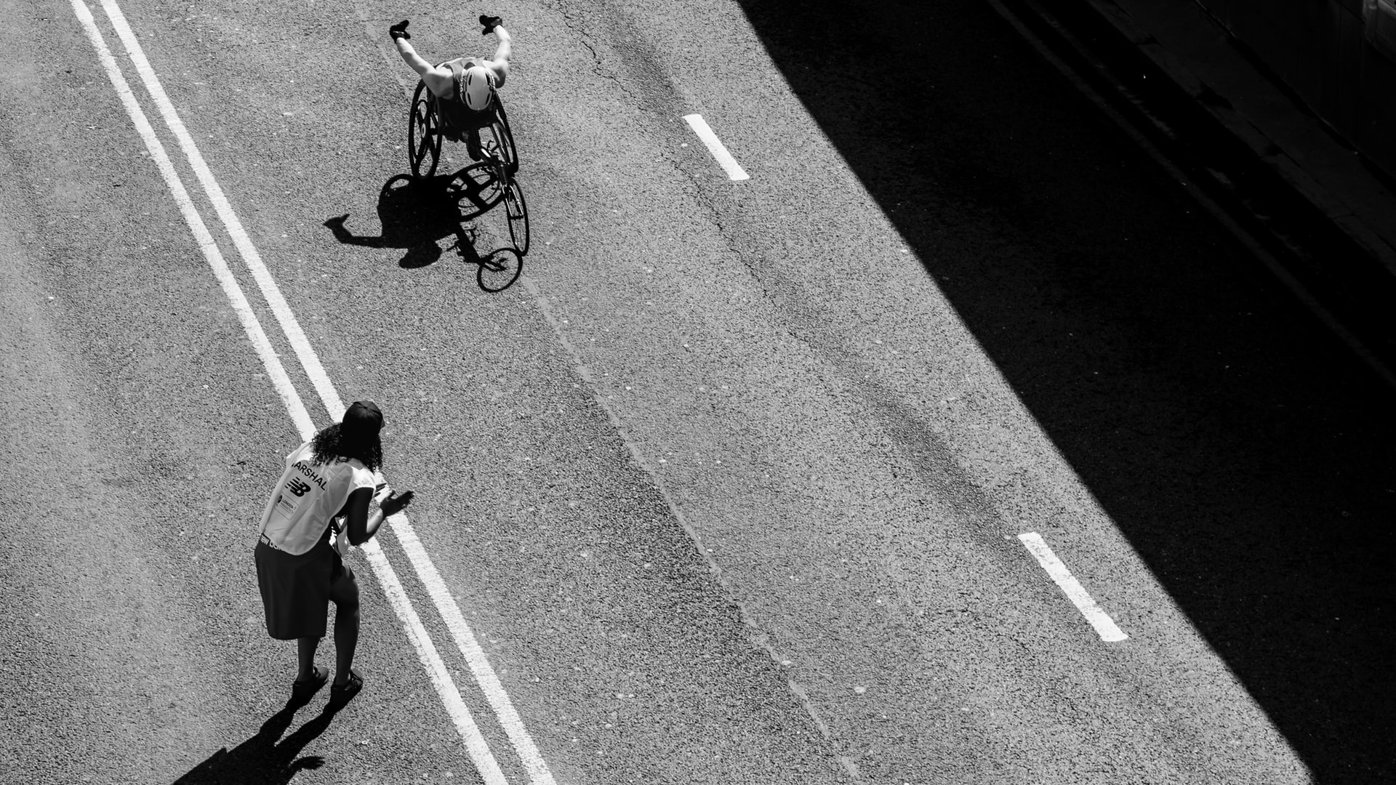
Contents
03 Context & Method
06 Respondent Profile
  10 Organization Financial Profile
  16 Athletes Served
  20 Event Profile
  25 Summary

Slide 3

Adapted Sport Economic Impact
CONTEXT & METHOD
All in Sport Consulting, in partnership with Stitch Marketing Research and Huddle Up Group, conducted a benchmark study of expenditures and budgets of adapted sport organizations across the U.S.
Surveys were emailed to 324 contacts representing 262 organizations.
Fieldwork was conducted between July 28 - September 22, 2020.
55 organizations’ economic profiles are represented in the following report, including partial and complete survey responses.

Slide 4
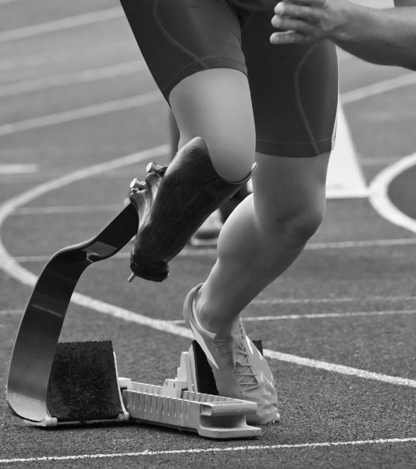
How do we interpret this data?
The benchmark study is an ongoing project that provides a benchmark of the economic impact of adapted sport organizations in the U.S. in 2019.
While the data collected is not comprehensive of all organizations, it sheds light on directional trends of the adapted sport industry, and is a sampling.
This data is representative of the participating organizations and is not a projection of the total market. Total market projects could be created from the data in this study, and would include assumptions regarding this pool’s proportion of the entire market in the U.S.
Partial survey responses have been included in this report to maximize insights. Data findings are annotated with respective respondent sample sizes.

Slide 5
Research
Findings

Slide 6
Respondent Profile
Organization type
Organizational role

Slide 7
Role in the Organization
Which best fits your role in your organization? You can mark more than one.
Most respondents are in leadership positions, with 61% executive directors, CEO, founders.
“Something else” roles include, for example:
  Assistant Program Director
  Operations Manager
  Membership Specialist
  Program Coordinator
  Director of Program Outreach
  Head Coach
[n=55]

Slide 8
Organization Types
Which of the below describes your organization? You can mark more than one.
Majority of organizations are nonprofits, some partnering with other categories.
[n=55]

Slide 9
Number of Employees
Approximately how many full-time, part-time and/or contract employees did your company have in 2019?
Organizations in the industry are heavily reliant on part-time workers and contractors – which make up roughly half of the workforce. These can include seasonal instructors, coaches, trainers, or those hired specifically for events.
[n=46]

Slide 10
Organization Financial Profile
Revenue estimates
Sources
Projections

Slide 11
Adapted Sport Organization Revenue 2019
Total Estimated Revenue of Organizations Represented: $79,030,000
Which of the following categories includes your organization’s revenue for calendar year 2019 (or fiscal equivalent)?
[n=45]
89% of organization revenue is under $3M for those who reported, with half of respondents reporting under $750K.
Total estimated revenue is calculated by averaging reported ranges and represented organizations.

Slide 12
Revenue Sources 2019
For that 2019 revenue, approximately what percentage of the organization’s revenue was from the following sources?
[n=45]
Donors (corporate and individual) and Grants make up 51% of revenue sources for organizations.

Slide 13
Revenue Projections in 2020 and 2021
In 2020/Looking ahead to 2021, what do you anticipate will be the change in revenue results versus 2019 (total contributions, program revenue, etc.)...?
[n=45]
With fieldwork conducted more than halfway through 2020, leadership anticipates a decrease in reported revenue for the year. While it was not explicitly asked, this is likely due to COVID-19 pandemic regulations restricting events and gatherings.
Forecasts for the subsequent 2021 are cautiously optimistic, with respondents predicting slight increases in revenue in the upcoming year.

Slide 14
Program Hours 2019
Total Estimated Program Hours: 291,000 hours
In 2019, how many total program hours did your program provide?
[n=34]
34 organizations reported their estimated program hours, with hours ranging from 100 to 85,000.

Slide 15
Program Hour Projections
[n=41]
Compared to 2018, program hours have increased, overall, as reported by organization leadership.
Following similar trends as the revenue projections, leadership predicts decreased hours for the 2020 year, but forecasts increases in 2021.

Slide 16
Athletes Served
Profile (Age/Gender)
Military/Veterans
Competitive level

Slide 17
Athletes Served – Ages
What percentage of the athletes you served in 2019 were in the age groups below?
[n=38]
Average percentages of athletes served in 2019 across 38 organizations that reported.
Nearly half of athletes served are under age 25, including 15% true youth athletes (12 and under). The age mix is notably diverse, however, with another 14% being the contingent ages 55+.

Slide 18
Athletes Served – Gender, Military Status
What percentage of the athletes you served in 2019 were male versus female?
What percentage of the athletes you served in 2019 were military/veterans?
[n=38]
[n=38]

Slide 19
Competitive Level
What percentage of the athletes you served in 2019 were in the following competitive groups/types?
[n=37]
The avidity level served is polarized in the surveyed group. This is likely indicative of the dynamic in the market overall.
Recreational ranges from 0%-100%
Development ranges from 0%-85%
Elite ranges from 0%-40%
While the most visible athletes are elite or Paralympic-level, this report indicates that the majority of athletes served are interested in Recreation sports, interested in sports for fun and/or socializing.

Slide 20
Event Profile
Event profile – when & where
Participants, spectators, athletes
Staff, volunteers

Slide 21
Number of Events Evaluated
Total Number of Events: 134
Organizations that hold either one event or 10 or more represent half of all represented respondents – again, showing the polarity of the industry.
Note: survey respondents were capped at reporting on 10 events, so this calculation is conservative.
[n=37]
Total estimated events calculated with organizations reported average number of events.

Slide 22
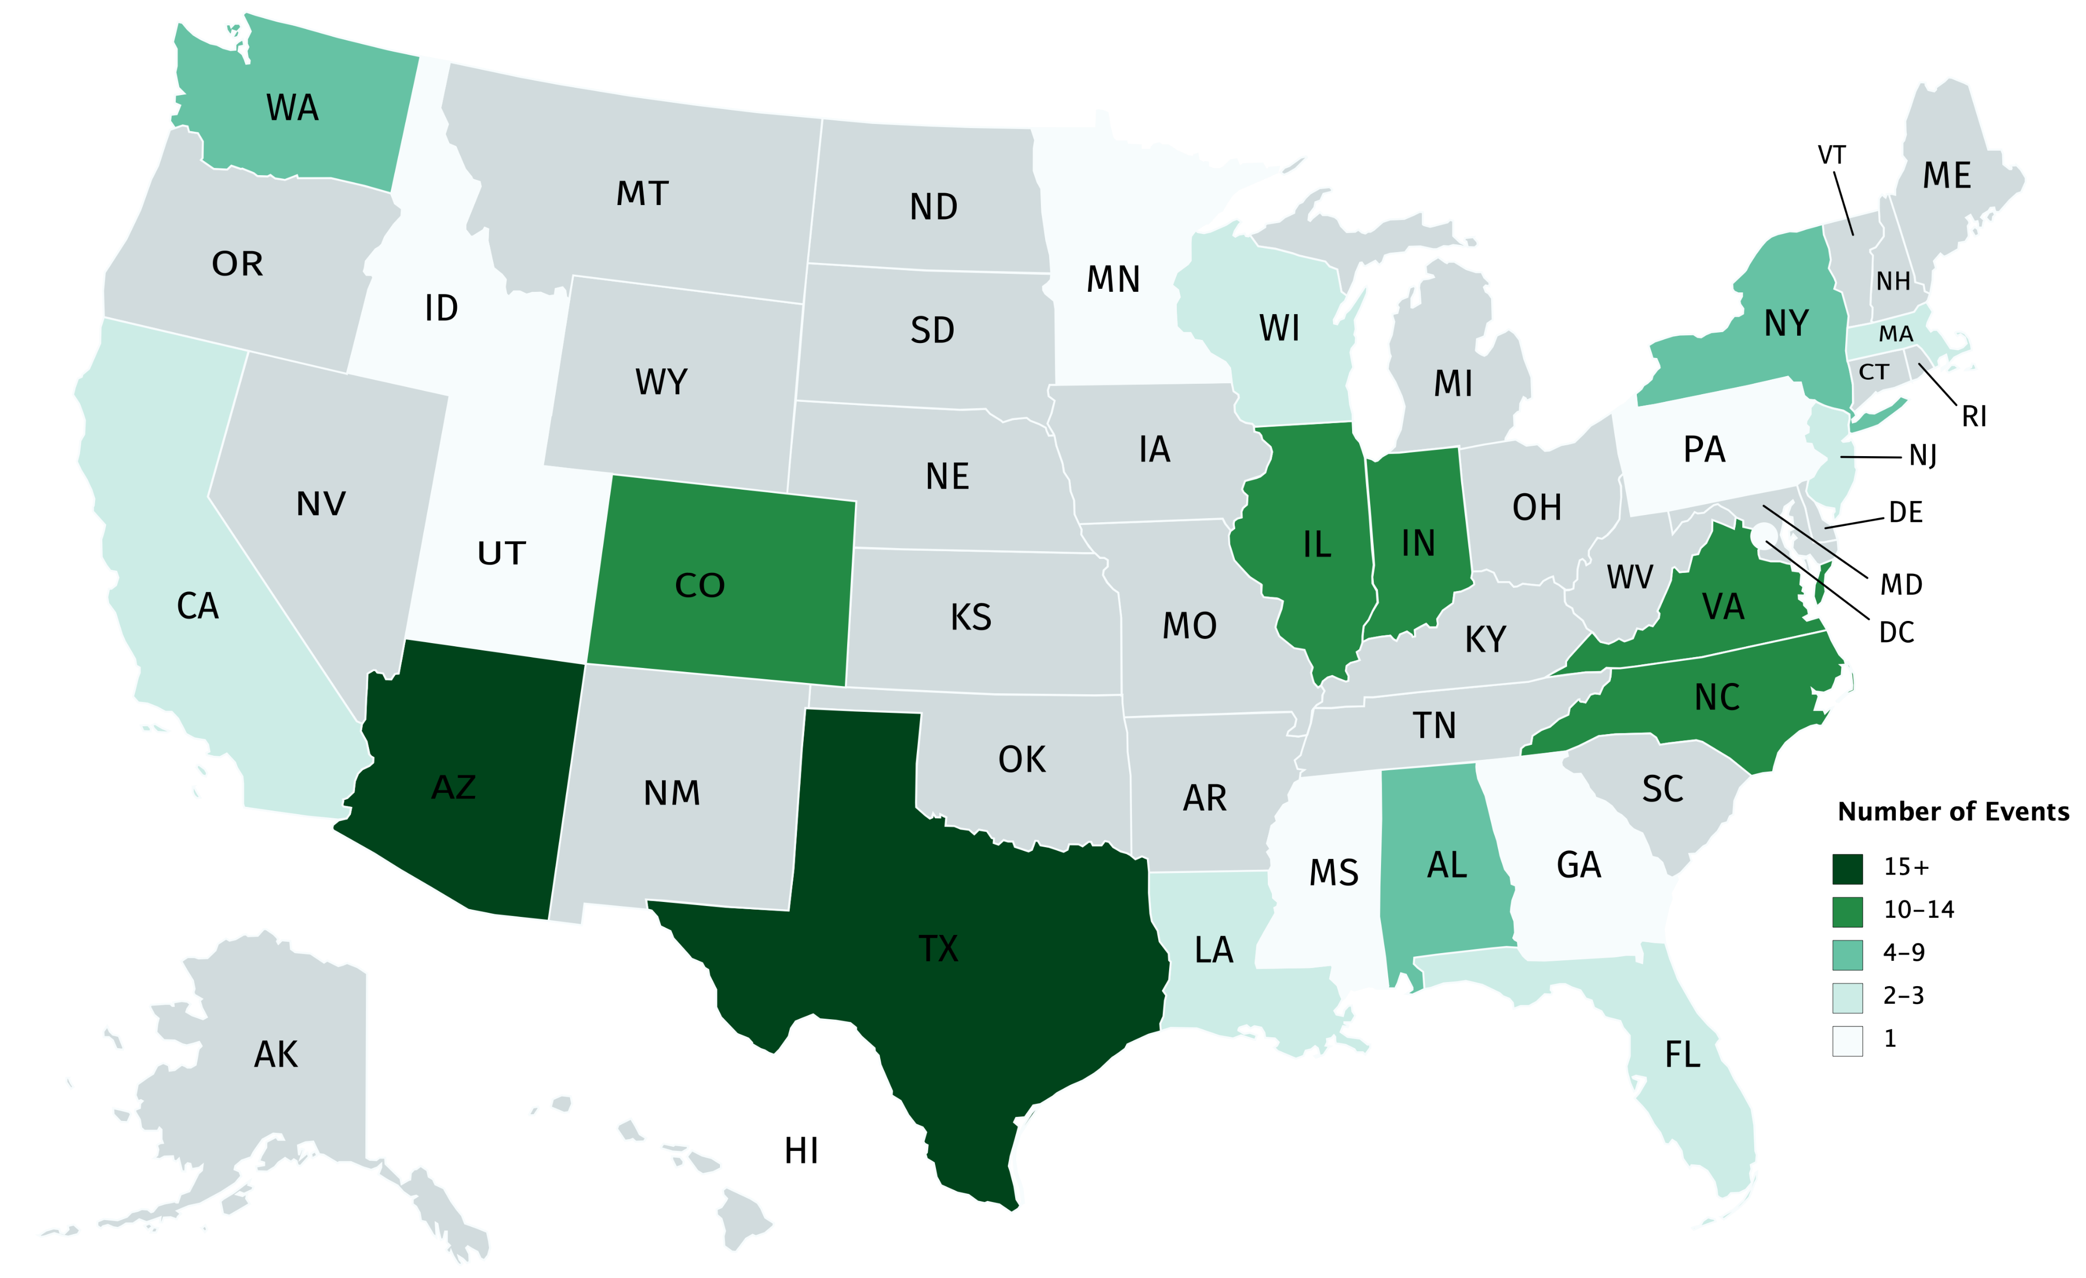
Events – Geography
Event locations across the U.S.
23 states represented (plus the District of Columbia)
[n=30; not all respondents who indicated they held events were able to provide locations]

Slide 23
Events – Month and Length
Total Event Days: 353
[n=30]
Approximately one-third of events reported occurred in the early months of 2019.
Total estimated days are calculated using organization events and length of time. This is a conservative number, as respondents were capped at reporting “more than 5 days”.

Slide 24
Events – Participants
Total Event Participants: 130,412
Total participants are calculated based on organization responses. Estimates based on athletes per team are included, with additional participants as listed above from 30 organizations.

Slide 25
Para Events Economic Impact

Slide 26
Para Events Economic Impact – 2019 Events Evaluated
Para Events Economic Impact: $26,850,862
Based on 2019 EI survey data from Sports & Events Tourism Association or SportsETA of the organizations represented in this survey.
The above estimate is a conservative representation of economic impact. Organizations that completed this survey were able to report on a maximum of 10 events, with a cap of “5 or more” days per event.
Note: Total EI based on a summary of one day events and multi-day events, with calculations taking into account events that would not include hotel room stay and those that would include higher spend on room nights and travel.

Slide 27
Para Events Estimated Total Economic Impact – 2019
Para Events Est. Total Economic Impact: $80,550,000 – $134,250,000
The Economic Impacts for para-related tourism events is a range between 3x and 5x the estimated impact of the organizations in this sample.
As a conservative estimate, the organizations represent approximately one-fifth of the organizations in the population. Their event economic impact is significant, and is used to extrapolate the above range of total impact.

Slide 28
Q&A

Slide 29

stitchmarketingresearch.com
619-894-7712
2159 India St
San Diego, CA 92101

